Slide 1

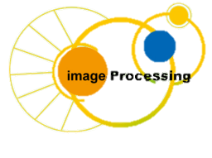
C Programing
Prof. John Y. Chiang
Dept. of Computer Science & Engineering
National Sun Yat-sen University
chiang@cse.nsysu.edu.tw
http://image.cse.nsysu.edu.tw

Slide 2
Contents
1 C Overview
2 Selection and Decision
3 Repetition and Loops
4 Function
5 Arrays
6 Pointers I
7 Pointers II
8 Structure
9 Link list
10 Class and object
I Number system

Slide 3
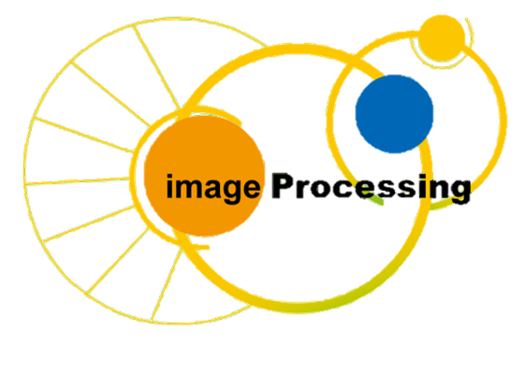
Lecture 7
Pointers II

Slide 4
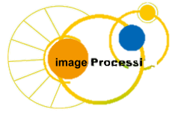
Outline
Calling Functions by Reference
Bubble Sort Using Call by Reference
Pointer Expressions and Pointer Arithmetic
The Relationship between Pointers and Arrays
Arrays of Pointers
Case Study: A Card Shuffling and Dealing Simulation
Pointers to Functions

Slide 5
Calling Functions by Reference
Call by reference with pointer arguments
    Pass address of argument using & operator
    Allows you to change actual location in memory
    Arrays are not passed with & because the array name is already a pointer

Slide 6
Calling Functions by Reference
* operator
    Used as alias/nickname for variable inside of function
    void double(int *number)
    {
    *number = 2 * (*number);
    }
    *number used as nickname for the variable passed

Slide 7
Example: Pass by Reference
Modify behavior in argument passing
void f(int j)
{
j = 5;
}
void g()
{
int i = 3;
f(i);
}
void f(int *ptr)
{
*ptr = 5;
}
void g()
{
int i = 3;
f(&i);
}
i = ?
i = 3
i = ?
i = 5

Slide 8
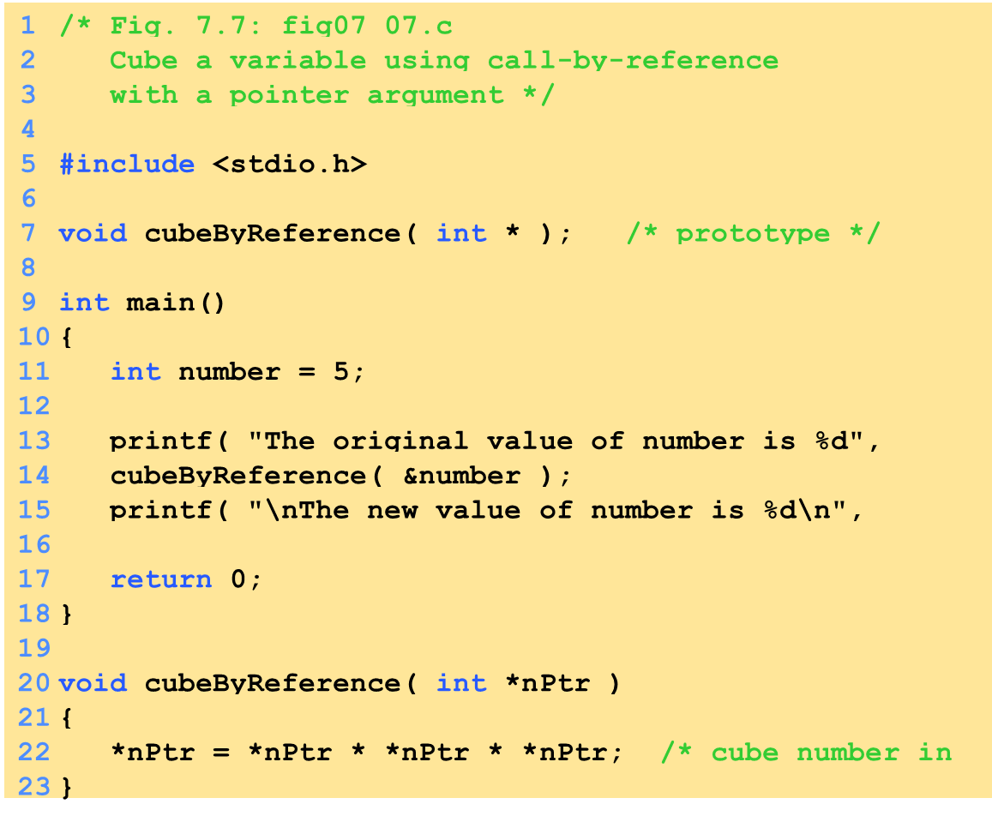
1. Function prototype - takes a pointer to an int.
1.1 Initialize variables
2. Call function
3. Define function
Notice how the address of number is given - cubeByReference expects a pointer (an address of a variable).
Inside cubeByReference, *nPtr is used (*nPtr is number).

Slide 9
The original value of number is 5
The new value of number is 125
Program Output

Slide 10
Bubble Sort Using Call-by-reference
Implement bubblesort using pointers
    Swap two elements
    swap function must receive address (using &) of array elements
        Array elements have call-by-value default
    Using pointers and the * operator, swap can switch array elements

Slide 11
Bubble Sort Using Call-by-reference
Psuedocode
    Initialize array
    print data in original order
    Call function bubblesort
    print sorted array
    Define bubblesort

Slide 12
Bubble Sort Using Call-by-reference
sizeof
    Returns size of operand in bytes
    For arrays: size of 1 element * number of elements
    if sizeof( int ) equals 4 bytes, then
        int myArray[ 10 ];
        printf( "%d", sizeof( myArray ) );
        will print 40
sizeof can be used with
    Variable names
    Type name
    Constant values

Slide 13
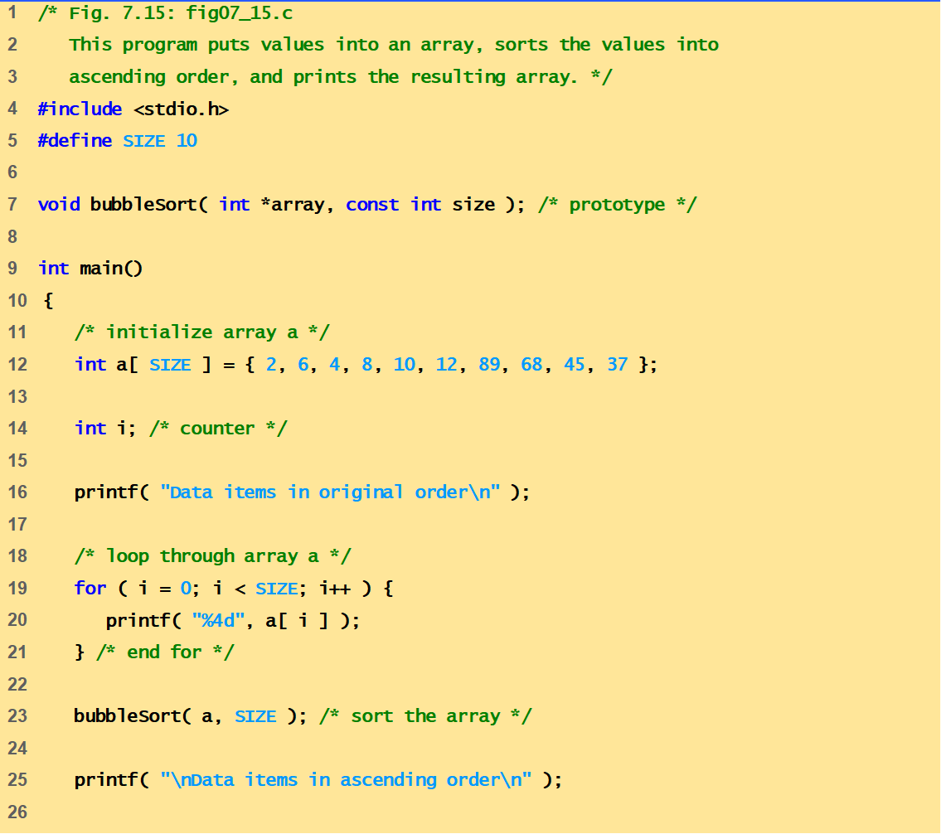
fig07_15.c
(Part 1 of 3)

Slide 14
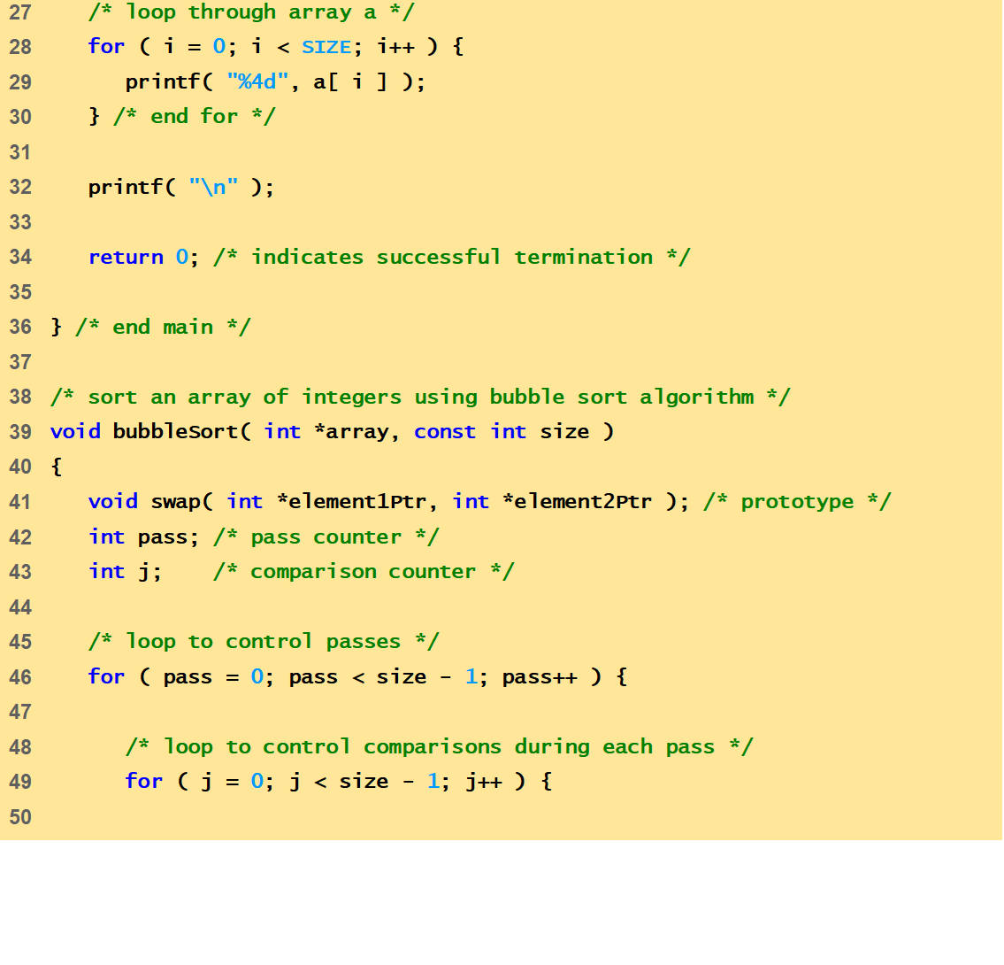
fig07_15.c
(Part 2 of 3)

Slide 15
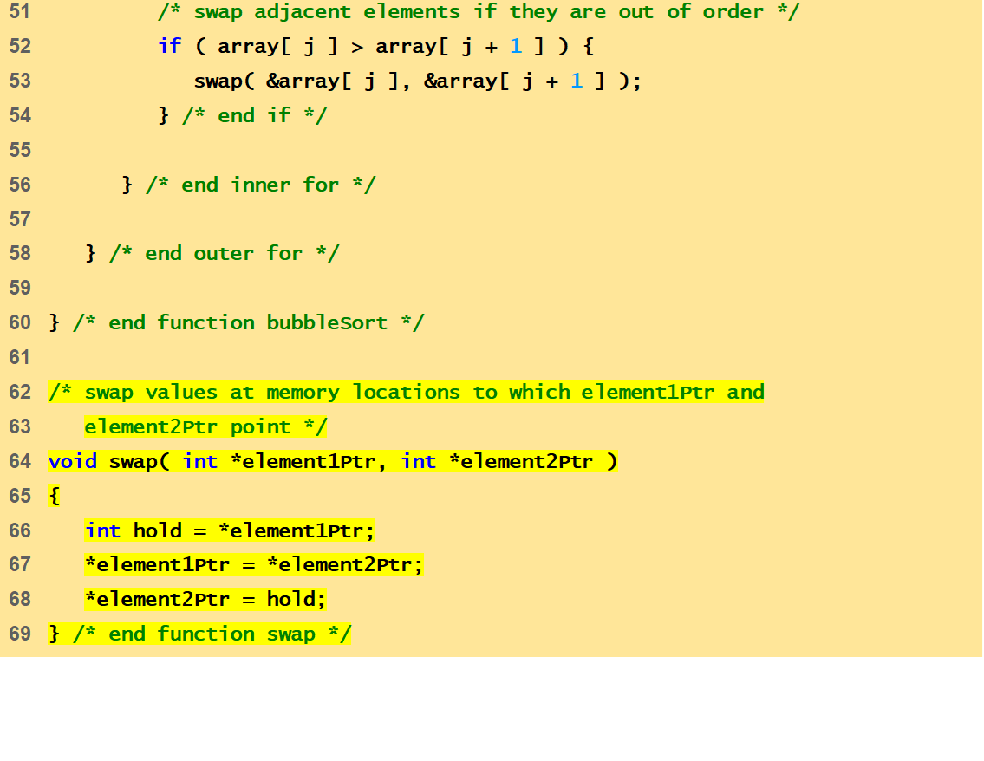
fig07_15.c
(Part 3 of 3)
Program Output
Data items in original order
2 6 4 8 10 12 89 68 45 37
Data items in ascending order
2 4 6 8 10 12 37 45 68 89

Slide 16
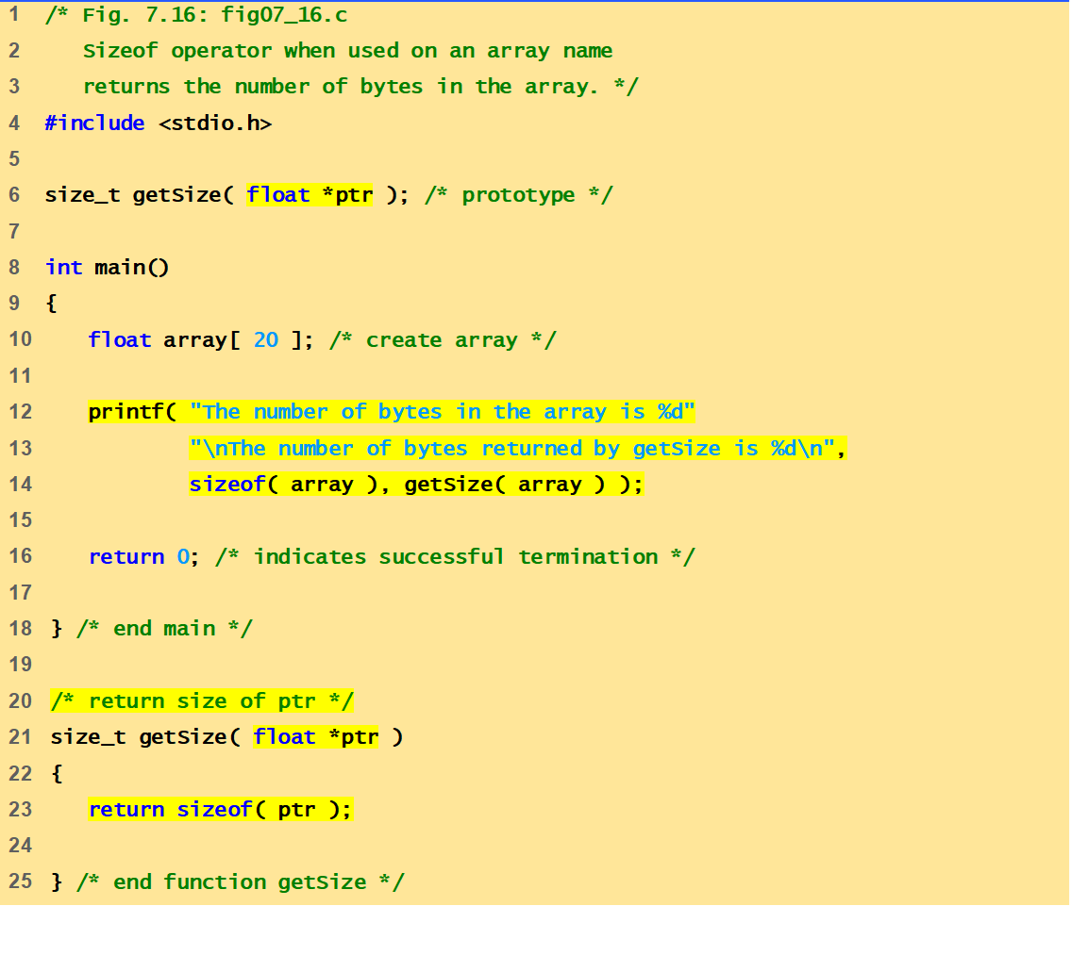
fig07_16.c
Program Output
The number of bytes in the array is 80
The number of bytes returned by getSize is 4

Slide 17
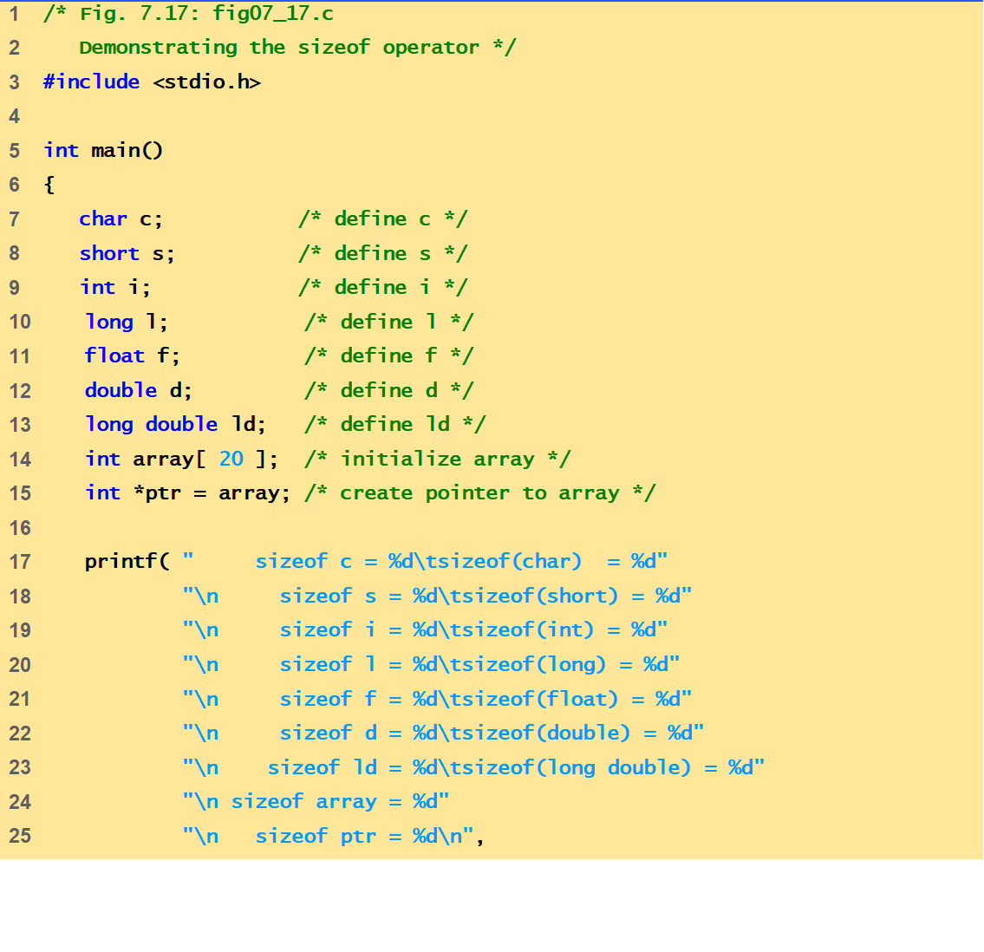
fig07_17.c
(Part 1 of 2)

Slide 18
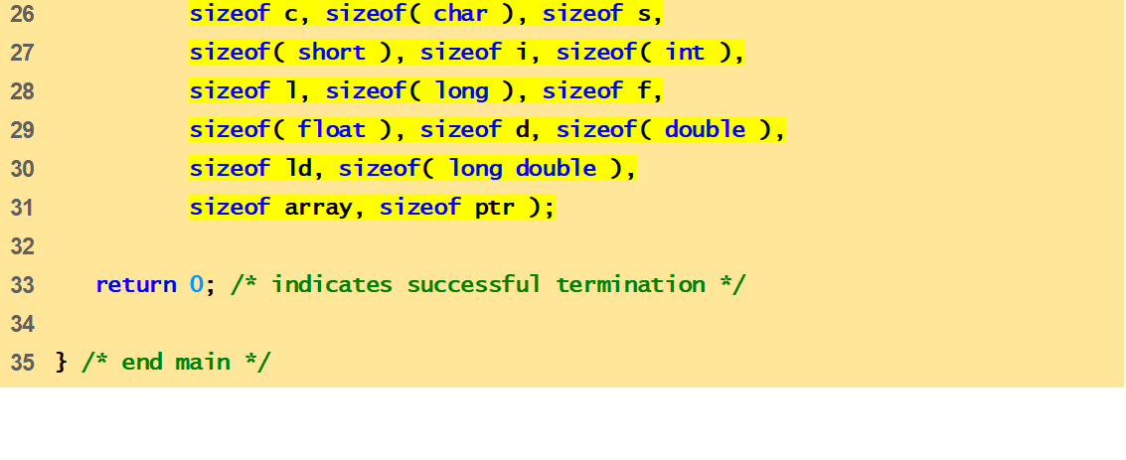
fig07_17.c
(Part 2 of 2)
Program Output
sizeof c = 1 sizeof(char) = 1
sizeof s = 2 sizeof(short) = 2
sizeof i = 4 sizeof(int) = 4
sizeof l = 4 sizeof(long) = 4
sizeof f = 4 sizeof(float) = 4
sizeof d = 8 sizeof(double) = 8
sizeof ld = 8 sizeof(long double) = 8
sizeof array = 80
sizeof ptr = 4

Slide 19
Pointer Expressions and
Pointer Arithmetic
Arithmetic operations can be performed on pointers
    Increment/decrement pointer (++ or --)
    Add an integer to a pointer( + or += , - or -=)
    Pointers may be subtracted from each other
    Operations meaningless unless performed on an array

Slide 20
Pointer Expressions and
Pointer Arithmetic
What’s ptr + 1?
    The next memory location!
What’s ptr - 1?
    The previous memory location!
What’s ptr * 2 and ptr / 2?
    Invalid operations!!!

Slide 21
Pointer Expressions and
Pointer Arithmetic
pointer + number pointer – number
E.g., pointer + 1 adds 1 something to a pointer
char *p;
char a;
char b;
p = &a;
p += 1;
int *p;
int a;
int b;
p = &a;
p += 1;
In each, p now points to b
(Assuming compiler doesn’t reorder variables in memory)
Adds 1*sizeof(char) to the memory address
Adds 1*sizeof(int) to the memory address
Pointer arithmetic should be used cautiously

Slide 22
Pointer Expressions and
Pointer Arithmetic
5 element int array on machine with 4 byte ints
    vPtr points to first element v[ 0 ]
        at location 3000 (vPtr = 3000)
    vPtr += 2; sets vPtr to 3008
        vPtr points to v[ 2 ] (incremented by 2), but the machine has 4 byte ints, so it points to address 3008
location
3000
3004
3008
3012
3016
v[0]
v[1]
v[2]
v[3]
v[4]
pointer variable vPtr

Slide 23
Pointer Expressions and
Pointer Arithmetic
Subtracting pointers
    Returns number of elements from one to the other. If
        vPtr2 = v[ 2 ];
        vPtr = v[ 0 ];
    vPtr2-vPtr would produce 2
Pointer comparison ( <, == , > )
    See which pointer points to the higher numbered array element
    Also, see if a pointer points to 0

Slide 24
Pointer Expressions and
Pointer Arithmetic
Pointers of the same type can be assigned to each other
    If not the same type, a cast operator must be used
    Exception: pointer to void (type void *)
        Generic pointer, represents any type
        No casting needed to convert a pointer to void pointer
        void pointers cannot be dereferenced

Slide 25
The Relationship Between
Pointers and Arrays
Arrays and pointers closely related
    Array name like a constant pointer
    Pointers can do array subscripting operations
Define an array b[ 5 ] and a pointer bPtr
    To set them equal to one another use:
        bPtr = b;
        The array name (b) is actually the address of first element of the array b[ 5 ]
        bPtr = &b[ 0 ];
        Explicitly assigns bPtr to address of first element of b

Slide 26
The Relationship Between
Pointers and Arrays
    Element b[ 3 ]
        Can be accessed by *(bPtr + 3)
            Where n is the offset. Called pointer/offset notation
        Can be accessed by bptr[ 3 ]
            Called pointer/subscript notation
            bPtr[ 3 ]same as b[ 3 ]
        Can be accessed by performing pointer arithmetic on the array itself
            *( b + 3 )

Slide 27
Pointer Arithmetic and Array
Type of a is float *
a[2] ⬅⬅➔ *(a + 2)
    ptr = &(a[2])
    ➔ptr = &(*(a + 2))
    ➔ptr = a + 2
a is a memory address constant
ptr is a pointer variable
float a[4];
float *ptr;
ptr = &(a[2]);
*ptr = 3.14;
ptr++;
*ptr = 9.0;
ptr = ptr - 3;
*ptr = 6.0;
ptr += 2;
*ptr = 7.0;

Slide 28
Arrays and Pointers
int i;
int array[10];
for (i = 0; i < 10; i++)
{
array[i] = …;
}
int *p;
int array[10];
for (p = array; p < &array[10]; p++)
{
*p = …;
}
These two blocks of code are functionally equivalent

Slide 29
Strings
In C, strings are just an array of characters
    Terminated with ‘\0’ character
    Arrays for bounded-length strings
    Pointer for constant strings (or unknown length)
char str1[15] = “Hello, world!\n”;
char *str2 = “Hello, world!\n”;
C, …
H
e
l
l
o
,
w
o
r
l
d
!
\n
terminator
C terminator: ’\0’
Pascal, Java, …
length
H
e
l
l
o
,
w
o
r
l
d
!
\n

Slide 30
String length
Must calculate length:
Provided by standard C library: #include <string.h>
int
strlen(char str[])
{
int len = 0;
while (str[len] != ‘\0’)
len++;
return (len);
}
can pass an
array or pointer
array access to pointer!
Check for
terminator
What is the size of the array???

Slide 31
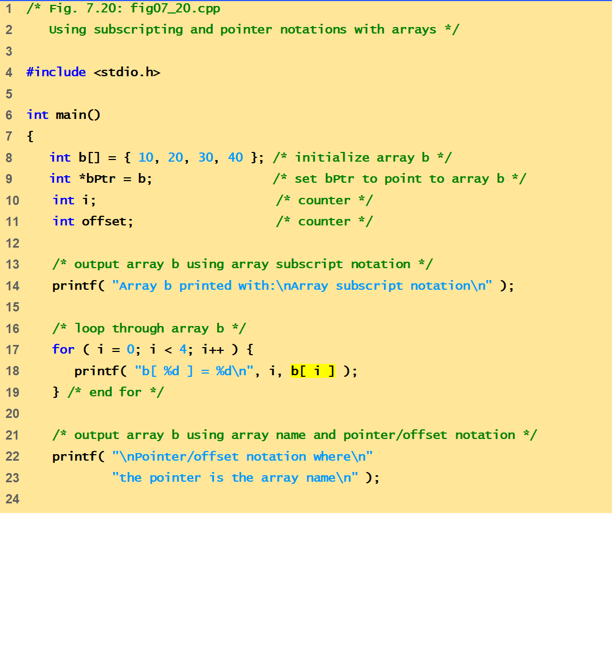
fig07_20.c
(Part 1 of 2)

Slide 32
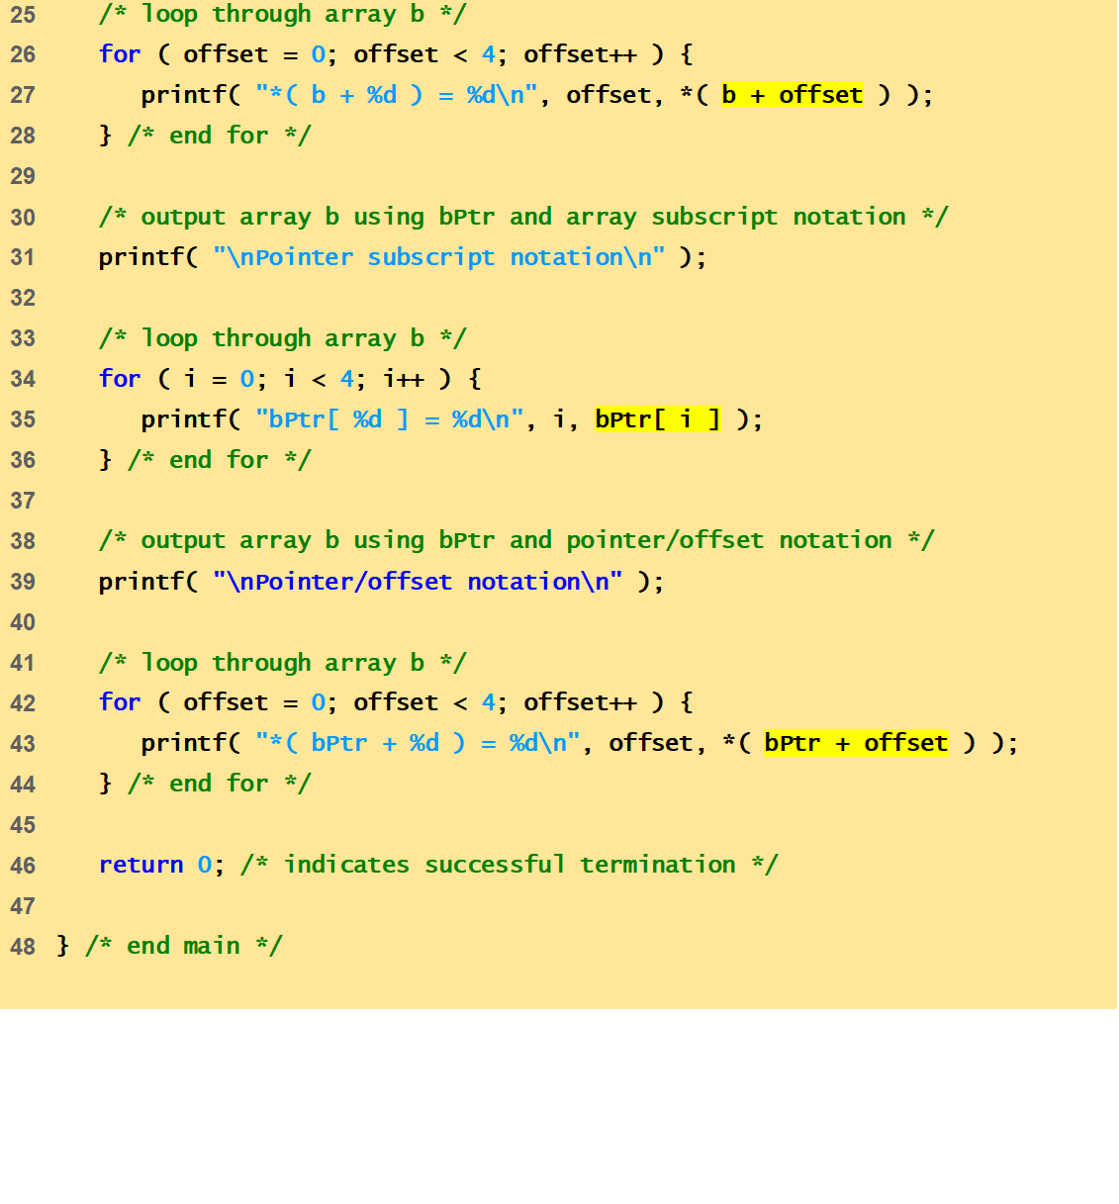
fig07_20.c
(Part 2 of 2)

Slide 33
Array b printed with:
Array subscript notation
b[ 0 ] = 10
b[ 1 ] = 20
b[ 2 ] = 30
b[ 3 ] = 40
Pointer/offset notation where
the pointer is the array name
*( b + 0 ) = 10
*( b + 1 ) = 20
*( b + 2 ) = 30
*( b + 3 ) = 40
Pointer subscript notation
bPtr[ 0 ] = 10
bPtr[ 1 ] = 20
bPtr[ 2 ] = 30
bPtr[ 3 ] = 40
Pointer/offset notation
*( bPtr + 0 ) = 10
*( bPtr + 1 ) = 20
*( bPtr + 2 ) = 30
*( bPtr + 3 ) = 40
Program Output

Slide 34
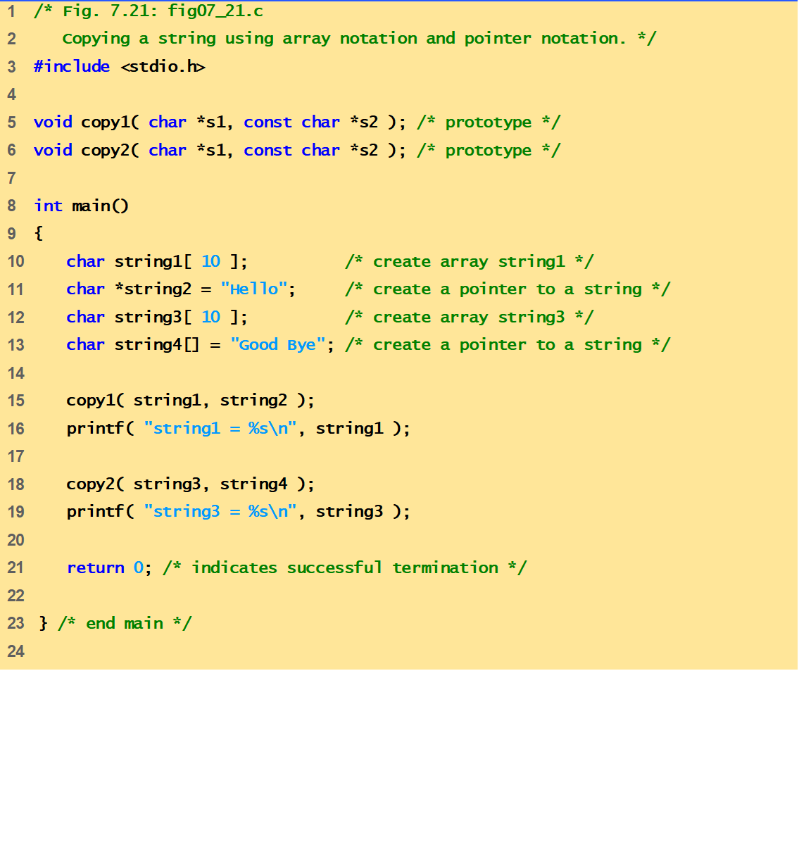
fig07_21.c
(Part 1 of 2)

Slide 35
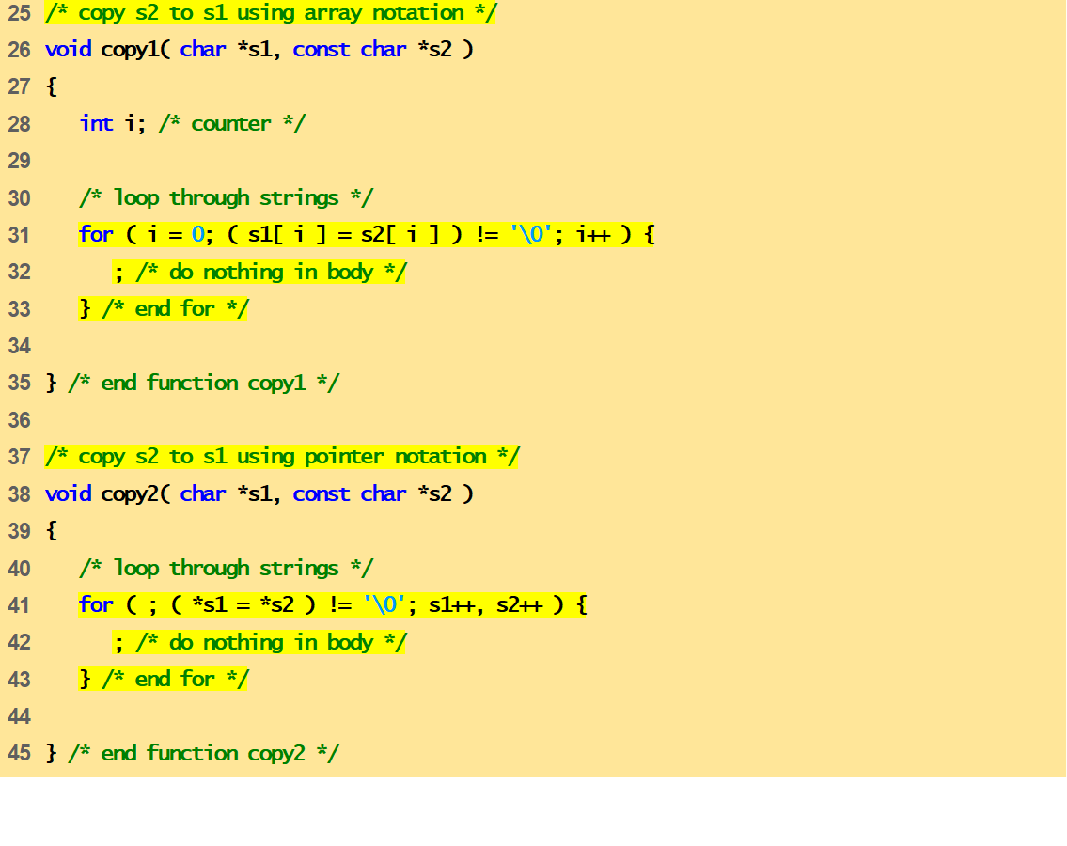
fig07_21.c
(Part 2 of 2)
Program Output
string1 = Hello
string3 = Good Bye

Slide 36
Pointer Arithmetic and Array
float a[4];
float *ptr;
ptr = &(a[2]);
*ptr = 3.14;
ptr++;
*ptr = 9.0;
ptr = ptr - 3;
*ptr = 6.0;
ptr += 2;
*ptr = 7.0;
Data Table
Name | Type | Description | Value
a[0] | float | float array element (variable) | ?
a[1] | float | float array element (variable) | ?
a[2] | float | float array element (variable) | ?
a[3] | float | float array element (variable) | ?
ptr | float * | float pointer variable
*ptr | float | de-reference of float pointer variable | ?

Slide 37
Pointer Arithmetic and Array
float a[4];
float *ptr;
ptr = &(a[2]);
*ptr = 3.14;
ptr++;
*ptr = 9.0;
ptr = ptr - 3;
*ptr = 6.0;
ptr += 2;
*ptr = 7.0;
Data Table
Name | Type | Description | Value
a[0] | float | float array element (variable) | ?
a[1] | float | float array element (variable) | ?
a[2] | float | float array element (variable) | ?
a[3] | float | float array element (variable) | ?
ptr | float * | float pointer variable | address of a[2]
*ptr | float | de-reference of float pointer variable | ?

Slide 38
Pointer Arithmetic and Array
float a[4];
float *ptr;
ptr = &(a[2]);
*ptr = 3.14;
ptr++;
*ptr = 9.0;
ptr = ptr - 3;
*ptr = 6.0;
ptr += 2;
*ptr = 7.0;
Data Table
Name | Type | Description | Value
a[0] | float | float array element (variable) | ?
a[1] | float | float array element (variable) | ?
a[2] | float | float array element (variable) | 3.14
a[3] | float | float array element (variable) | ?
ptr | float * | float pointer variable | address of a[2]
*ptr | float | de-reference of float pointer variable | 3.14

Slide 39
Pointer Arithmetic and Array
float a[4];
float *ptr;
ptr = &(a[2]);
*ptr = 3.14;
ptr++;
*ptr = 9.0;
ptr = ptr - 3;
*ptr = 6.0;
ptr += 2;
*ptr = 7.0;
Data Table
Name | Type | Description | Value
a[0] | float | float array element (variable) | ?
a[1] | float | float array element (variable) | ?
a[2] | float | float array element (variable) | 3.14
a[3] | float | float array element (variable) | ?
ptr | float * | float pointer variable | address of a[3]
*ptr | float | de-reference of float pointer variable | ?

Slide 40
Pointer Arithmetic and Array
float a[4];
float *ptr;
ptr = &(a[2]);
*ptr = 3.14;
ptr++;
*ptr = 9.0;
ptr = ptr - 3;
*ptr = 6.0;
ptr += 2;
*ptr = 7.0;
Data Table
Name | Type | Description | Value
a[0] | float | float array element (variable) | ?
a[1] | float | float array element (variable) | ?
a[2] | float | float array element (variable) | 3.14
a[3] | float | float array element (variable) | 9.0
ptr | float * | float pointer variable | address of a[3]
*ptr | float | de-reference of float pointer variable | 9.0

Slide 41
Pointer Arithmetic and Array
float a[4];
float *ptr;
ptr = &(a[2]);
*ptr = 3.14;
ptr++;
*ptr = 9.0;
ptr = ptr - 3;
*ptr = 6.0;
ptr += 2;
*ptr = 7.0;
Data Table
Name | Type | Description | Value
a[0] | float | float array element (variable) | ?
a[1] | float | float array element (variable) | ?
a[2] | float | float array element (variable) | 3.14
a[3] | float | float array element (variable) | 9.0
ptr | float * | float pointer variable | address of a[0]
*ptr | float | de-reference of float pointer variable | ?

Slide 42
Pointer Arithmetic and Array
float a[4];
float *ptr;
ptr = &(a[2]);
*ptr = 3.14;
ptr++;
*ptr = 9.0;
ptr = ptr - 3;
*ptr = 6.0;
ptr += 2;
*ptr = 7.0;
Data Table
Name | Type | Description | Value
a[0] | float | float array element (variable) | 6.0
a[1] | float | float array element (variable) | ?
a[2] | float | float array element (variable) | 3.14
a[3] | float | float array element (variable) | 9.0
ptr | float * | float pointer variable | address of a[0]
*ptr | float | de-reference of float pointer variable | 6.0

Slide 43
Pointer Arithmetic and Array
float a[4];
float *ptr;
ptr = &(a[2]);
*ptr = 3.14;
ptr++;
*ptr = 9.0;
ptr = ptr - 3;
*ptr = 6.0;
ptr += 2;
*ptr = 7.0;
Data Table
Name | Type | Description | Value
a[0] | float | float array element (variable) | 6.0
a[1] | float | float array element (variable) | ?
a[2] | float | float array element (variable) | 3.14
a[3] | float | float array element (variable) | 9.0
ptr | float * | float pointer variable | address of a[2]
*ptr | float | de-reference of float pointer variable | 3.14

Slide 44
Pointer Arithmetic and Array
float a[4];
float *ptr;
ptr = &(a[2]);
*ptr = 3.14;
ptr++;
*ptr = 9.0;
ptr = ptr - 3;
*ptr = 6.0;
ptr += 2;
*ptr = 7.0;
Data Table
Name | Type | Description | Value
a[0] | float | float array element (variable) | 6.0
a[1] | float | float array element (variable) | ?
a[2] | float | float array element (variable) | 7.0
a[3] | float | float array element (variable) | 9.0
ptr | float * | float pointer variable | address of a[2]
*ptr | float | de-reference of float pointer variable | 7.0

Slide 45
Arrays of Pointers
Arrays can contain pointers
For example: an array of strings
    Strings are pointers to the first character
    char * – each element of suit is a pointer to a char
char *suit[ 4 ] = { "Hearts", "Diamonds","Clubs", "Spades" };

Slide 46
Arrays of Pointers
    The strings are not actually stored in the array suit, only pointers to the strings are stored
    suit array has a fixed size, but strings can be of any size
suit[0]
’H’
’e’
’a’
’r’
’t’
’s’
’\0’
suit[1]
’D’
’i’
’a’
’m’
’o’
’n’
’d’
’s’
’\0’
suit[2]
’C’
’l’
’u’
’b’
’s’
’\0’
suit[3]
’S’
’p’
’a’
’d’
’e’
’s’
’\0’

Slide 47
Case Study: Sort lines of text
of different length
How can we do this?:
    Store lines end-to-end in one big char array . \n will delimit lines.
    Store pointers in a different array where each pointer points to 1st char of each new line.
    Compare two lines using strcmp() standard library function.
    If 2 lines are out of order -- swap pointer in pointer array.

Slide 48
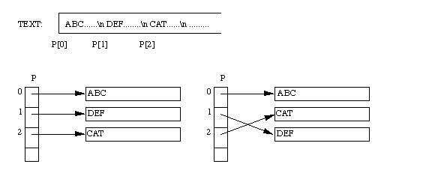
Case Study: Sort lines of text
of different length

Slide 49
Pointers to Functions
Pointer to function
    Contains address of function
    Similar to how array name is address of first element
    Function name is starting address of code that defines function
Function pointers can be
    Passed to functions
    Stored in arrays
    Assigned to other function pointers

Slide 50
Pointers to Functions
Example: bubblesort
    Function bubble takes a function pointer
        bubble calls this helper function
        this determines ascending or descending sorting
    The argument in bubblesort for the function pointer:
        int ( *compare )( int a, int b )
        tells bubblesort to expect a pointer to a function that takes two ints and returns an int
    If the parentheses were left out:
        int *compare( int a, int b )
        Defines a function that receives two integers and returns a pointer to a int

Slide 51
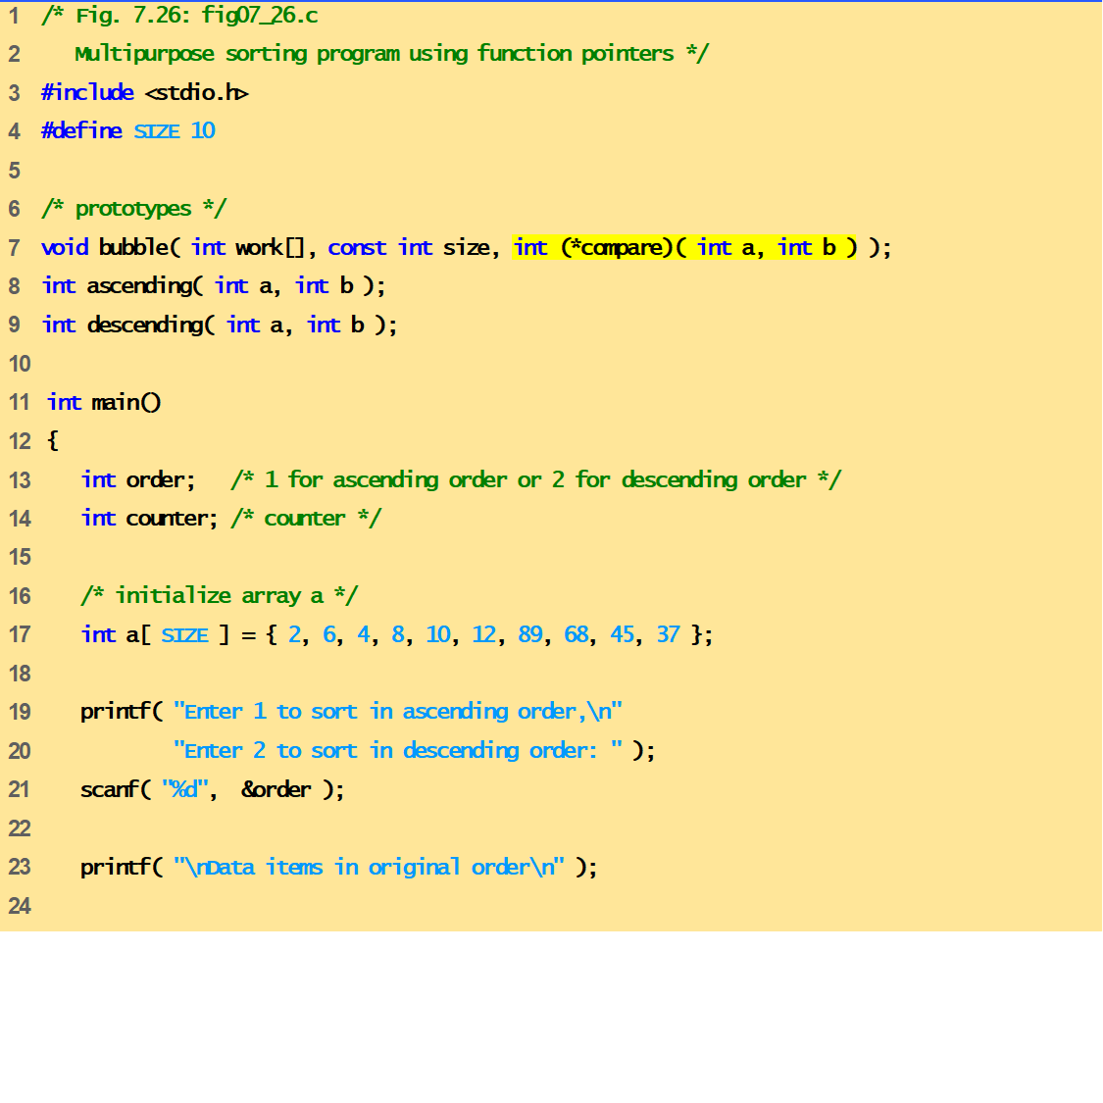
fig07_26.c
(Part 1 of 4)

Slide 52
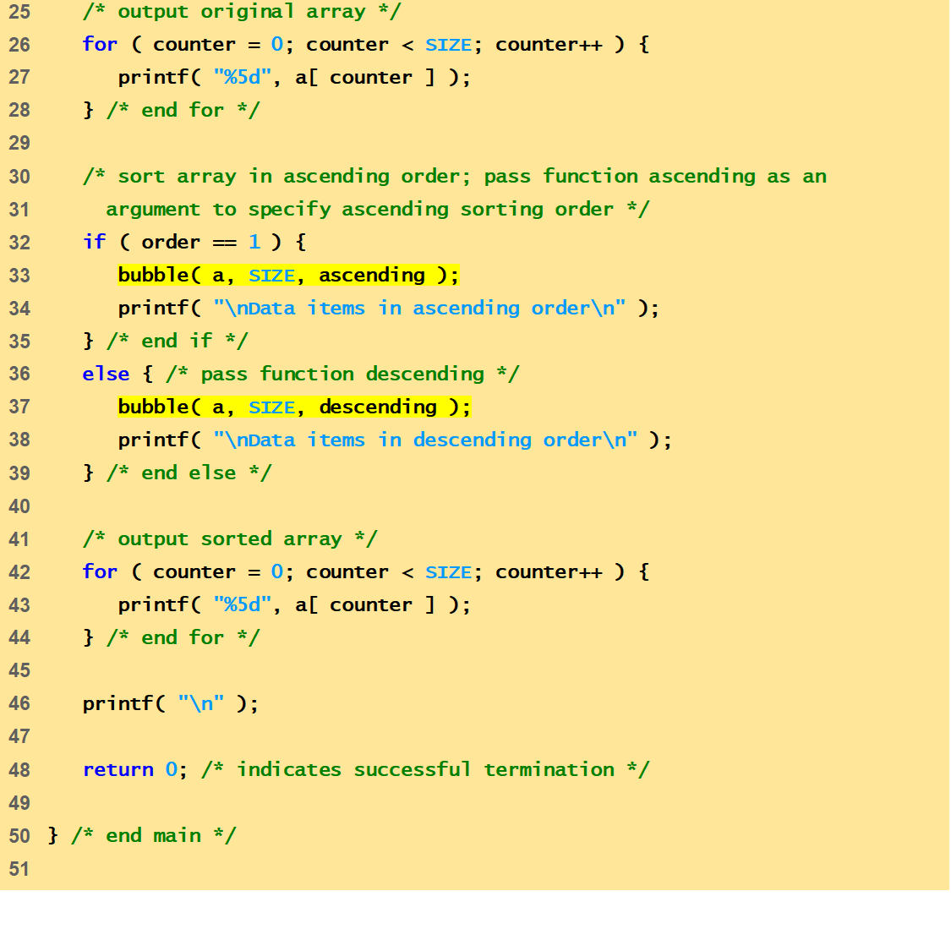
fig07_26.c
(Part 2 of 4)

Slide 53
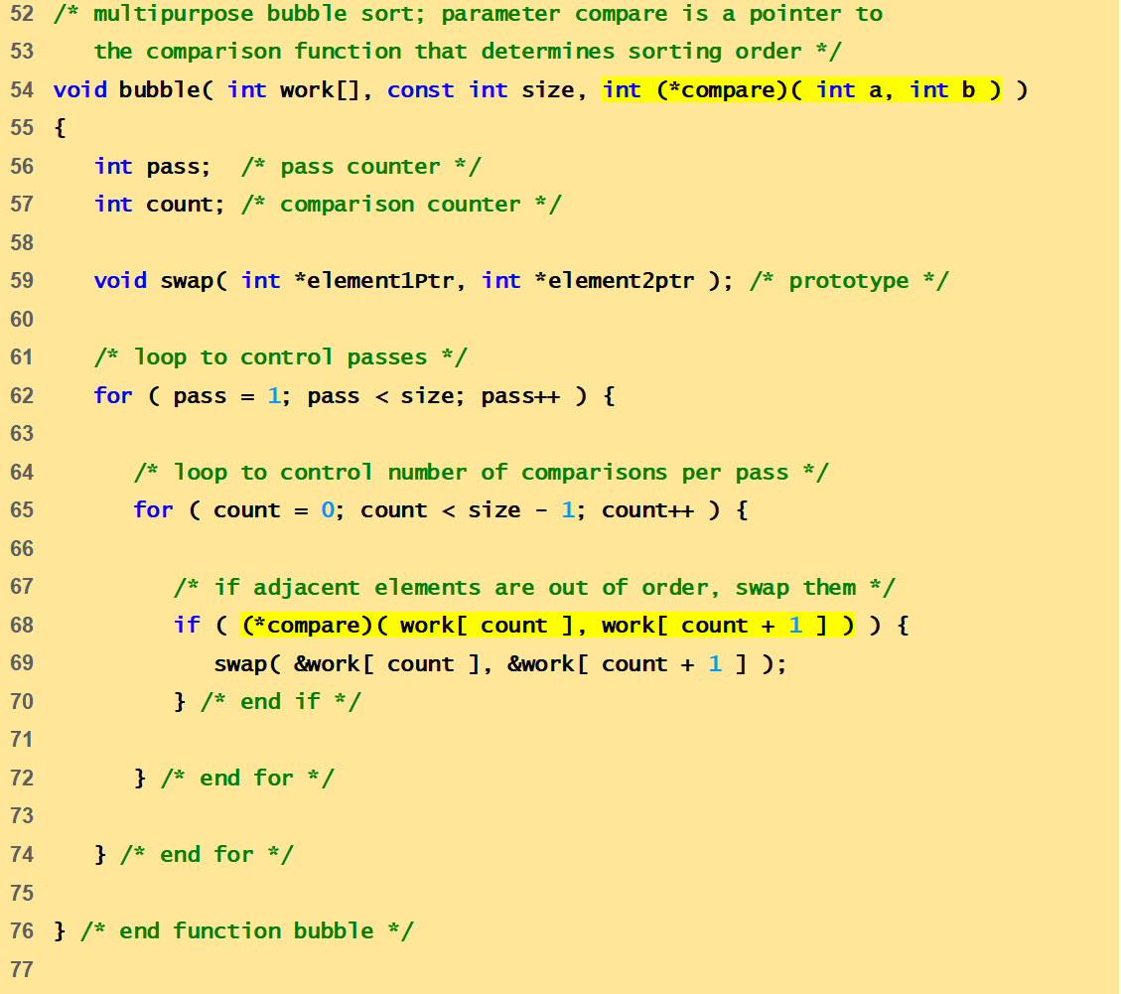
fig07_26.c
(Part 3 of 4)

Slide 54
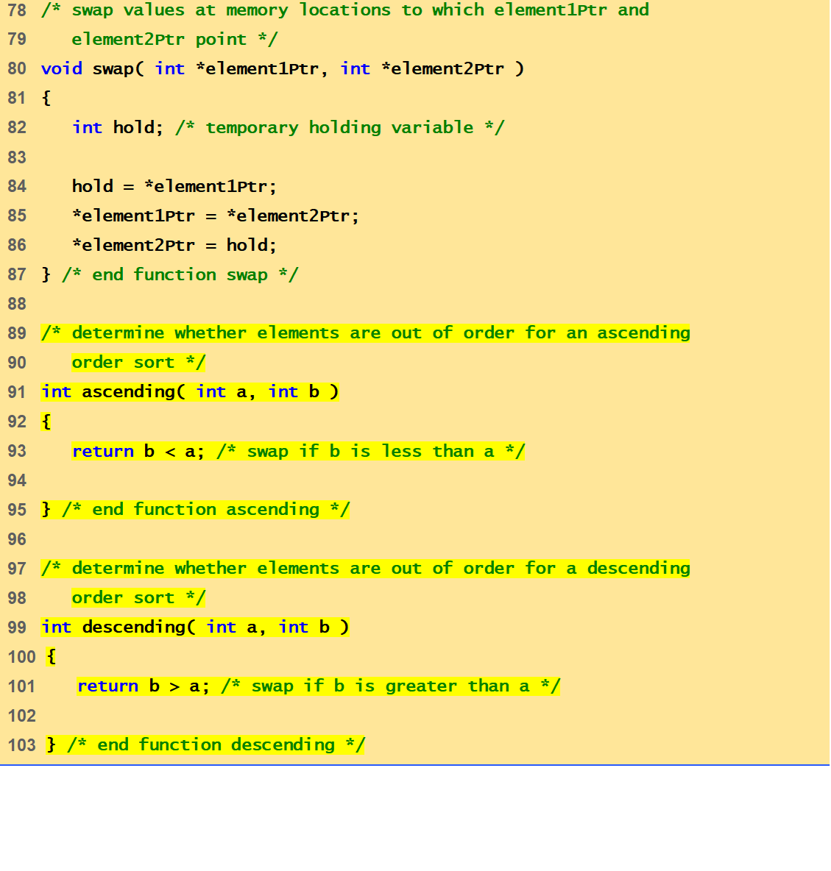
fig07_26.c
(Part 4 of 4)

Slide 55
Enter 1 to sort in ascending order,
Enter 2 to sort in descending order: 1
Data items in original order
2 6 4 8 10 12 89 68 45 37
Data items in ascending order
2 4 6 8 10 12 37 45 68 89
Program Output
Enter 1 to sort in ascending order,
Enter 2 to sort in descending order: 2
Data items in original order
2 6 4 8 10 12 89 68 45 37
Data items in descending order
89 68 45 37 12 10 8 6 4 2

